Slide 1
Introduction to Health Informatics

Slide 2
Learning Objectives:
To understand the concept of Health Informatics
To understand the elements of Health Informatics
To understand the Health Informatics Context
Define the concept of an information system and its characteristics
Describe the different types of information systems
Describe various types of technologies that support health care information systems
Examine the challenges presented by emerging trends in information technology, social media, and global communications
Discuss the advantages and disadvantages of using the Internet as a platform for health care applications

Slide 3
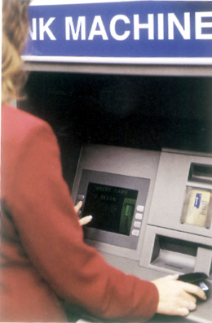
The (e)ATM of Healthcare

Slide 4
HIS
A health information system (HIS) is any form of structured repository of data, information, or knowledge that can be used to support health care delivery or to promote health development.
HIS should be part of the health technology assessment framework. Data is an essential element of HIS and it is usually an expensive resource. Investments in HIS should look into its opportunity costs and the efficacy/effectiveness of its potential contribution to health development

Slide 5
Why Health Informatics?
Health Informatics provides information to make decisions
Better information leads to better decisions
Health care, management, planning and policy all need good information

Slide 6
good information is needed to make decisions on
Health care,
health management,
health policy and
health planning

Slide 7
Health Informatics
The intersection of information science, computer science, and health care.
It deals with the resources, devices and methods required to optimize the acquisition, storage, retrieval and use of information in health.
Notes:
Multidisciplinary discipline/study/profession/approach of how people transform technology and how technology transforms people
Lies at the intersection of people, technology and information systems and focuses on the expanding relationship between information systems and the daily lives of real people
Helps develop new/better uses for information technology (IT) in order to design solutions that reflect the way people create, use and find information, and it takes into account the social, cultural, political and organizational settings in which those solutions will be used
Informatics includes the use of computers for change management, human-computer interactions, communications, risk management, organizational behavior, workflow redesign, productivity improvement, and organizational culture, safety, and quality.

Slide 8
Health informatics tools include
Tools
computers
clinical guidelines,
formal medical terminologies,
Information and communication systems.

Slide 9
Definition of health information system
An automated system that uses computer hardware and software to record, manipulate, store, recover, and disseminate data.
that is, a system that receives and processes input and provides output.

Slide 10
Inputs
  Order for a drug
Data
  Prescribed drug
Process
  Verifies drug is correct for the order
Outputs

Slide 11
Categories of IS
With regards to information systems, there are three major categories. They are
Transaction Processing System (TPS),
Management Information System (MIS), and
Decision Support System (DSS)

Slide 12
A transaction processing system (TPS)
A transaction processing system (TPS) processes information in order to complete a transaction.
Two examples are the Admit, discharge, transfer (ADT) and patient billing systems.

Slide 13
  An admission, discharge, and transfer system( ADR)
  This is the name given to software systems used in health care facilities that register and track patients from admission through discharge including transfers; usually interfaced with other systems used throughout a facility such as an electronic health record or lab information system”

Slide 14
Management Information System (MIS)
  Helps managers plan, organize, and evaluate their department
Examples:
  Laboratory department
  Emergency department

Slide 15
Emergency care INFORMATION SYSTEM
Dashboard systems
Communication systems
Clinical decision support
Documentation systems
Computerized training and information retrieval
Systems to facilitate public health surveillance

Slide 16
Emergency care INFORMATION SYSTEM
“dashboard systems that track and coordinate patient flow,
communications systems that enable ED physicians to link to patients’ records or providers,
clinical decision support programs that improve decision making,
documentation systems for collecting and storing patient data,
computerized training and information retrieval, and systems to facilitate public health surveillance

Slide 17
Decision support system (DSS)
Information system
  Gathers data from a variety of sources
  Assists in providing structure to the data
  Facilitates and improves the outcome of business and organizational decision-making activities
Example:
  Clinical DSS

Slide 18
Health Care Information
System (HCIS)
Information system used within a health care organization
  Facilitates communication
  Integrates information
  Documents health care interventions
  Performs record keeping
  Otherwise support the functions of the organization

Slide 19
HCIS components
Patient management and billing
Department management
Care delivery and clinical documentation
Clinical decision support
Financial and resource management

Slide 20
Patient Management and Billing
Systems that support the management of the patient
  Example
    Patient identification
  Supporting technology
    Master patient index
      Patient-identifying directory
      Links to the patient record
      Facilitates patient identification
      Assists in maintaining a longitudinal patient record

Slide 21
MoH Health Informatics
provides leadership in the application of information and computer science and technology to public health practice, research, and learning.
  Electronic health record support the public health functions
  Use of health care records, population census and other public health data in supporting public health systems and analyses
  Basic capabilities that support public health practice such as statistical and health surveillance
  Public Health decision support

Slide 22
eHealth
eHealth is a broad term for healthcare practice which is supported by electronic processes and communication.
The term can encompass a range of services that are at the edge of medicine/healthcare and information technology.
Notes:
Since the term eHealth is widely used, it is useful to define it also and it's relationship to health informatics.
Unfortunately, the term eHealth has many informal meanings so it is difficult to define clearly and can lead to confusion.
eHealth has been applied to: telemedicine, patient centered health records and information access, health data collections, research using electronic records, and many other areas.
We prefer to use the more precise term health informatics to define the collection, manipulation, and use of health information.

Slide 23
mHealth
Mobile Health
Mobile technologies such as mobile phones collect and access health information.

Slide 24
Informatics ≠ IT
Information Technology is not Informatics
Information technology is hardware & software.
    IT is to nouns, as informatics is to verbs.
    Informatics helps IT ‘work appropriately.’
Notes:
Informatics is the collection, manipulation and use of information.
Information Technology is the hardware and software that Informatics uses.
There is debate about whether to call paper records an "information system" or "information technology" and whether or not it can be considered part of "informatics".
I believe that paper records should be considered part of the information system and should be considered as part of "health informatics". I would probably draw the line at considering it "information technology" (unless you have a very low bar for defining technology).

Slide 25
Key Elements of Informatics
Acquisition
Storage
Communication
Manipulation
Display
Notes:
Acquisition: capture data taking care to strive for quality (accurate, timely, reliable, complete)
Storage: save data so that it can be retrieved (the key term here is retrieval… the trash bin will store data but it is difficult to retrieve)
Communication: Data needs to be moved from point of collection to storage, for analysis, and finally to point of use (this may a very short distance and time where data is used near collection point or may be widely separated points.)
Manipulation: data usually needs to be manipulated in some way, combined with other data, aggregated, or compared
Display: How can the data be best displayed so that it can be easily understood and acted upon?

Slide 26
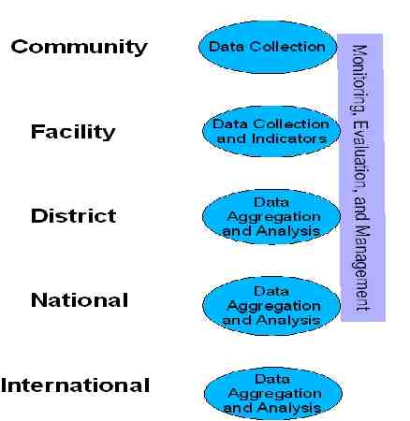
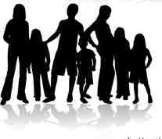
Health Information Systems Context
Notes:
We spend so much time looking at aggregate indicators that sometimes we forget:
- Data comes from individual people.
It is now becoming more necessary and feasible to:
- record information about individual people.
- share information at all levels (from individual patient care to management to planning to monitoring)
HIS stack now includes individual patient records in addition to community, facility, district, and national systems.
Traditionally, public health informatics has included only aggregate indicators such as those routinely collected from facilities on attendance, services, diseases.
However, chronic diseases such as HIV/AIDS, MDR TB, as well as diabetes, hypertension have made it essential to include individual medical records in health informatics.

Slide 27
Health Informatics Principles
Use drives data
Interoperability using open standards
Incremental development and strengthening of systems
Enterprise Architecture approach
Collaborative Communities
Notes:
Principles to apply health informatics.

Slide 28
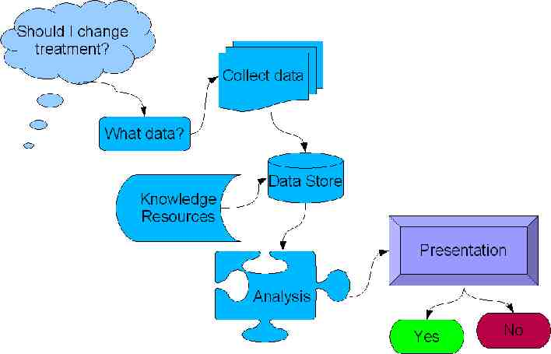
Decisions Determine Data
Notes:
This is the fundamental process that SHOULD take place for information system design.
START with the decision
Then, what data do we need?
How are we going to collect, store, communicate, analyze and present the information so that the decision can be made?
Ideally, the presentation should show a clear decision.

Slide 29


Encourage open systems
Notes:
Don't reinvent the wheel. Especially don't reinvent the wheel BADLY.
There is a lot of very capable open source software that is suitable for use in health informatics systems.
Make sure that you get maximum return on the system investment you make today by ensuring that you and others can reuse your developments.
Developers should work for you. Make sure that you control the process.

Slide 30
Make vs. Buy… Or Modify
Buy Software
  May not be an exact fit to your needs
Build Software
  Long expensive process not guaranteed to succeed.
Modify
  Start with open source software that you can modify
  Modified software to meet your exact requirements
  Everyone benefits from your investment in the software
Notes:
Often the decision on software is presented as a "build vs. buy" decision where you look for software that meets your needs and then buy it or you don't find software that meets your needs and then you have to build it from scratch.
There is another option that is increasingly attractive. This is the "modify" option. You can start with software that meets some of your needs or which has a useful basic architecture and then modify it to meet all of your needs. This option is difficult with commercial proprietary software which requires that the vendor be agreeable to make the changes. (Often local vendors are not skilled or not permitted to make changes.) However, with open source software, you have access to the underlying instructions "source code" to the software so it becomes a much more feasible project to make the changes yourself or to hire someone to make the changes.
Another advantage of this option is that the investment you make in changes to the software accrue to the benefit of you and others who use the software, rather than being locked up in a proprietary system

Slide 31
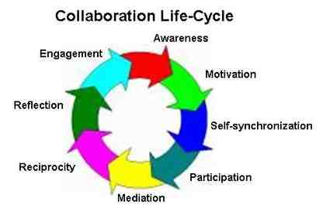
Collaborative communities of practice

Slide 32
eHealth
TeleConsultations
previously Telemedicine
Services
Notes:
eNursing
eDissemination of – personalised - Healthcare Professional Continuing Education
Public Health education & Information
LifeTime Health Records - longitudinal healthcare event recording - ePrevention

Slide 33
The eight Drivers Forcing Change TO TELEMEDICINE
Obligatory search for cost containment
Changing demographics
Peripheralisation of health care delivery
Changing disease patterns
Impact of information technology including IT support for clinical decisions - Telemedicine & eHealth
More informed and expectant patients C-Health
The well-being factor – responsibility shift into patients hands - The Wellness Paradigm
Knowledge Management – changing world

Slide 34
Examples of Telemedicine/ E-Health Applications
Diagnosis and treatment of patients at distant locations
Monitoring of patients with chronic illness/disease
Automated message reminders (e.g., medications, appointments)
Physician consultations
Patient portals of EHR systems

Slide 35
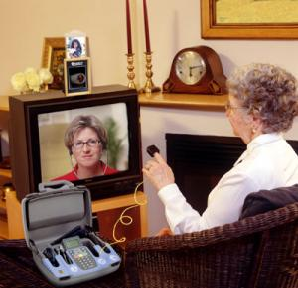
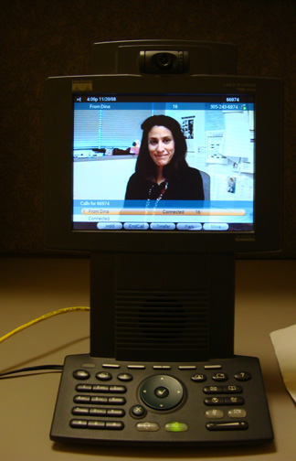

Slide 36
Examples of Telemedicine/ E-Health Applications
On-line peer support systems
Health websites that provide health-care information and resources and services
Prescription drug sale
Sale of medical equipment and supplies

Slide 37
Potential Advantages of Technology
Eliminates the need for patients and health care professionals to travel
Permits more flexible appointment scheduling
Permits easier access to a wider array of information and services especially for rural and underserved patients
Permits increased access to specialists
Permits asynchronous communication
Patient empowerment (e.g., well-informed questions; information on treatment options)

Slide 38
Potential Disadvantages of Technology
Proliferation of incorrect or inappropriate information
Proliferation of too much information
Potential disruptions in physician/patient relationships
Privacy issues
Technology breakdowns/failures
Promotes false sense of security
Potential for increasing health care disparities

Slide 39
Critical Question
Will older people be able to access and successfully adapt to and use telemedicine and e-health tools?
Notes:
39

Slide 40
Requirements of Meaningful Access to Health IT
Awareness of technology
Access to technology and technical support
Requisite knowledge and skills to use the technology
Able to comprehend and integrate the information and use the information appropriately

Slide 41
Barriers to Use of Healthcare Technologies
Limited knowledge of potential uses/benefits of technology
Cost
Rapid developments and changes in technical systems
Interphace issues
Use of most telemedicine and E-health tools require at least adequate levels of health literacy
Notes:
41

Slide 42
Barriers to Use of Healthcare Technologies
Older adults especially minority have lower health literacy than other segments of the populations
Human-technology interaction involves information processing and places demands on memory and other cognitive abilities
Age is associated with declines in some aspects of cognition

Slide 43
The Internet enables patients to make more informed decisions
Majority (59%) of physicians felt the Internet enables patients to make more informed decisions regarding health choices
  Helps patient understand their condition and their medications
  Helps patient in asking questions during the visit
  Allows patient to find out about more options than what was discussed by their provider
  Allows patient to be their own advocate

Slide 44
How can patients better prepare for office visits?
If using the Internet to get information, use major sites and stay away from commercial promotions; check the source and weigh the information accordingly
To improve communication, patients should not think that they have all of the answers based upon what they read online and be open to discussion with their physician

Slide 45
How can patients better prepare for office visits?
  “…you can’t expect to do medical school and residency training online in front of your computer in an evening before you go in to see your doctor… [use] what information you gather in order to spark discussion and [gain] information but [don’t come] to too many conclusions on something that is probably quite complicated.”

Slide 46
Electronic Medical Records
Examining the ability of older adults to use patient portals of EMRs to perform routine tasks and identify usability problems
Also gathering information on issues related to privacy and trust
Focus on lower SES populations with low health literacy

